Slide 1
E-Retail: Customer Retention Case Study Data Visualization

Slide 2

INTRODUCTION
Five major factors that contributed to the success of an e-commerce store have been identified as:
service quality
system quality
information quality
trust and
net benefit.

Slide 3
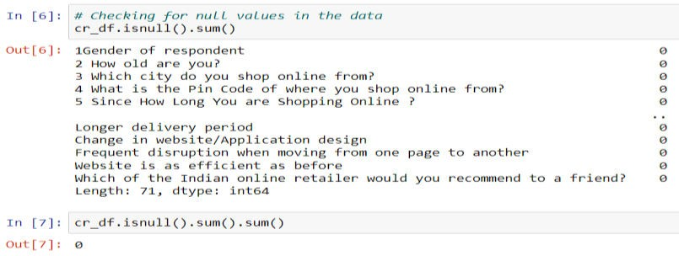
2. Exploratory Data Analysis

Slide 4
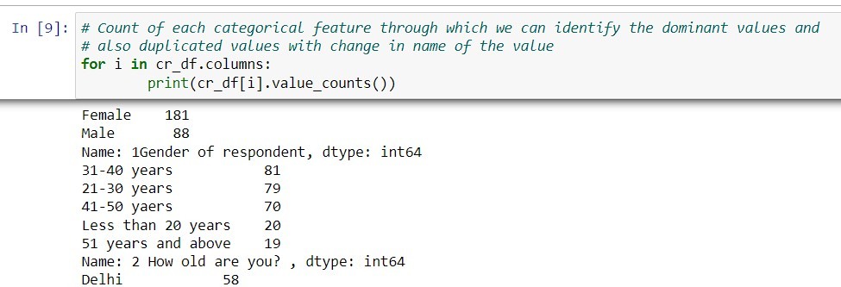
Column Names | count | unique | top | freq
1Gender of respondent | 269 | 2 | Female | 181
2 How old are you? | 269 | 5 | 31-40 years | 81
3 Which city do you shop online from? | 269 | 11 | Delhi | 58
5 Since How Long You are Shopping Online ? | 269 | 5 | Above 4 years | 98
6 How many times you have made an online purchase in the past 1 year? | 269 | 6 | Less than 10 times | 114
7 How do you access the internet while shopping on-line? | 269 | 3 | Mobile Internet | 189
8 Which device do you use to access the online shopping? | 269 | 4 | Smartphone | 141
9 What is the screen size of your mobile device? | 269 | 4 | Others | 134
10 What is the operating system (OS) of your device? | 269 | 3 | Window/windows Mobile | 122

Slide 5
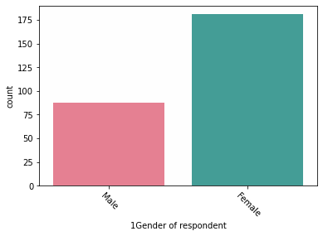
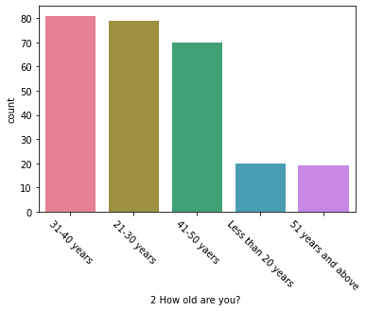
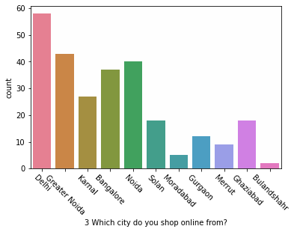
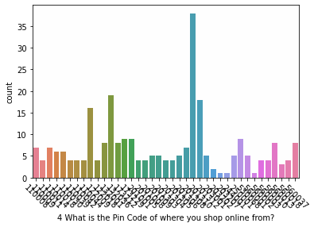
Count Plot

Slide 6
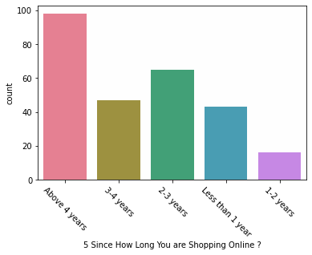
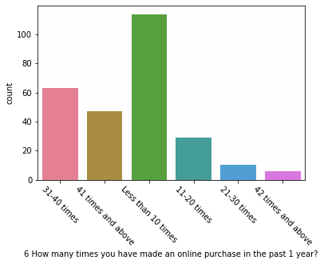
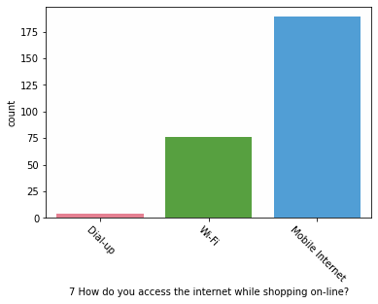
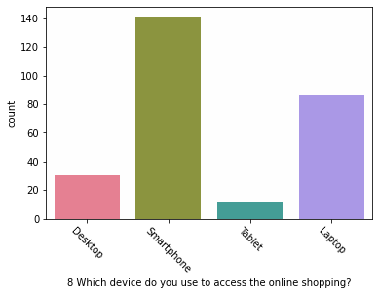
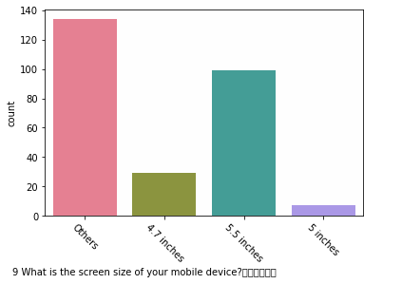
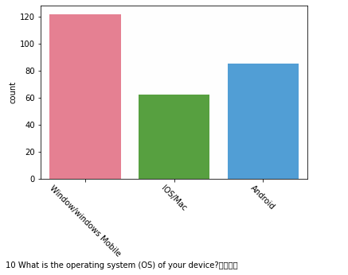

Slide 7
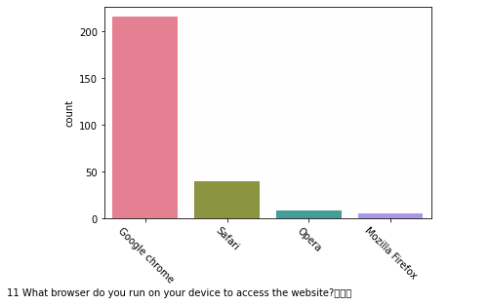
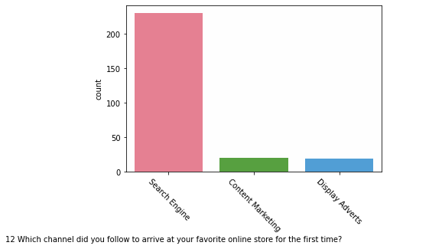

Slide 8
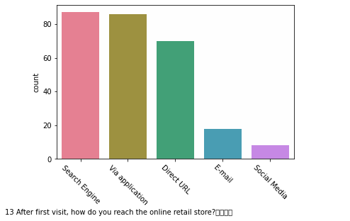
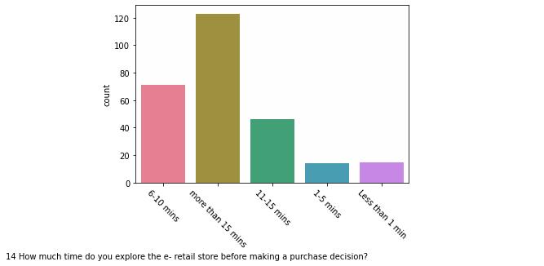
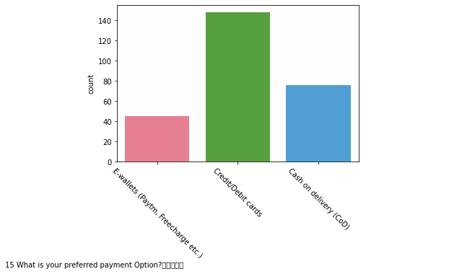
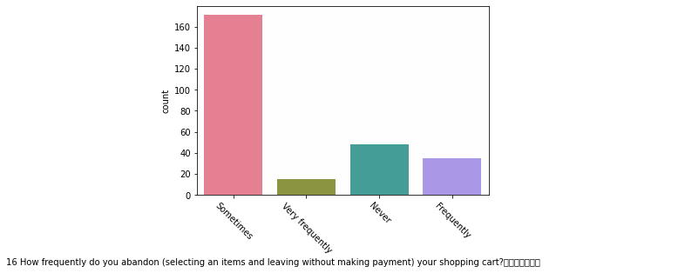

Slide 9
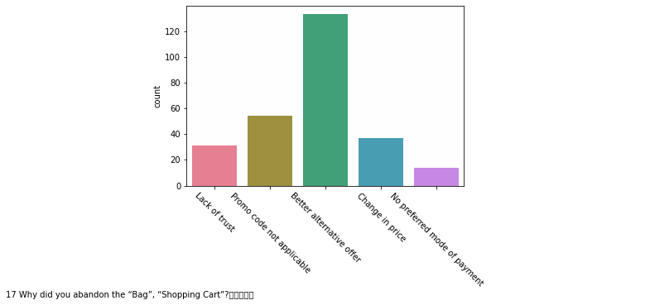
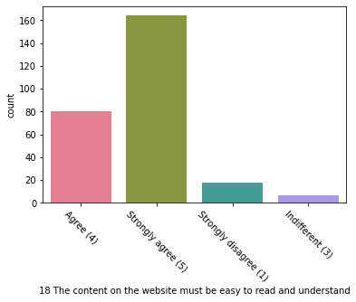
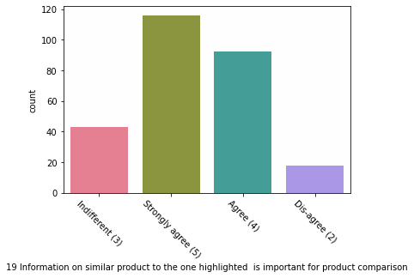
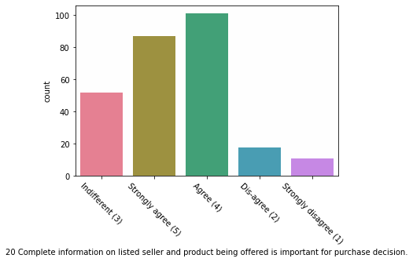

Slide 10
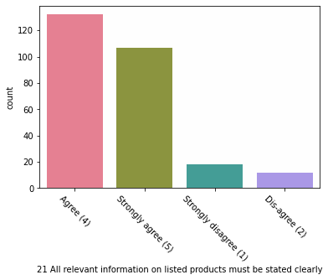
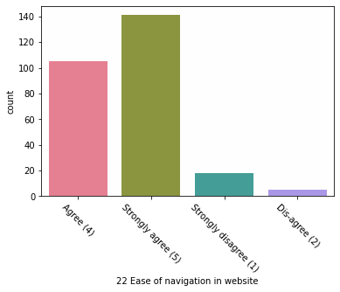
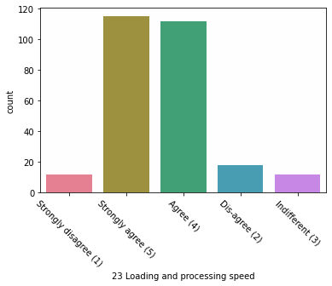
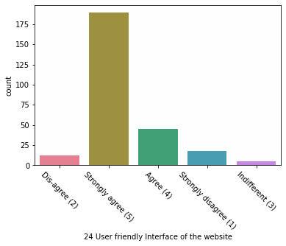

Slide 11
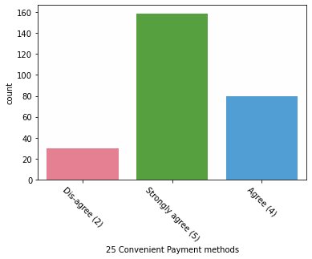
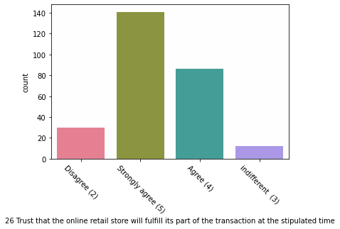
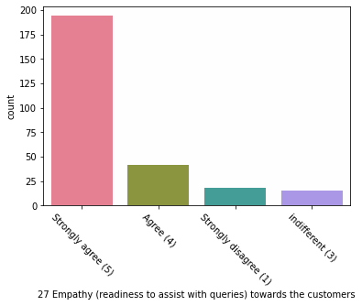
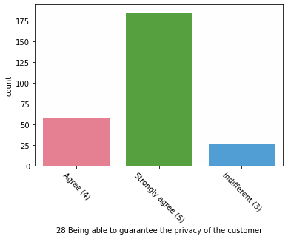

Slide 12
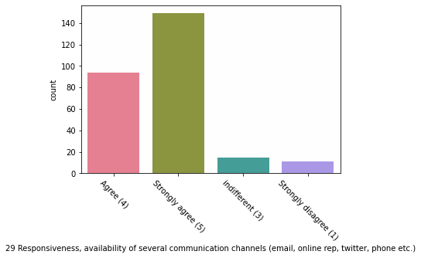
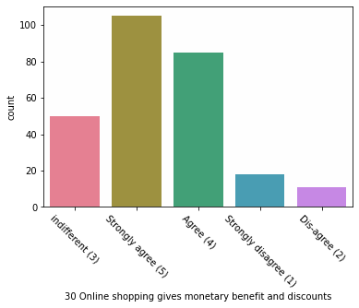
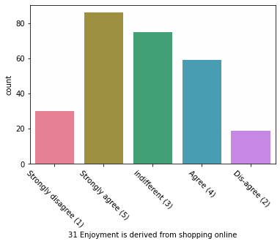
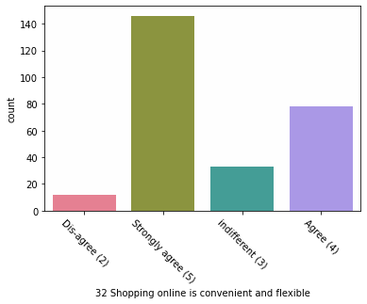

Slide 13
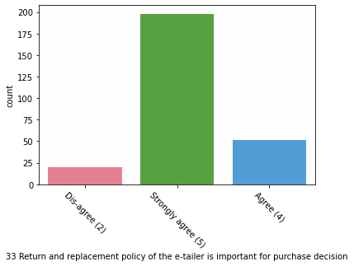
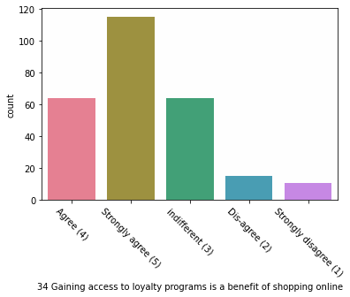
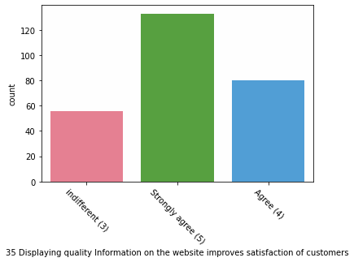
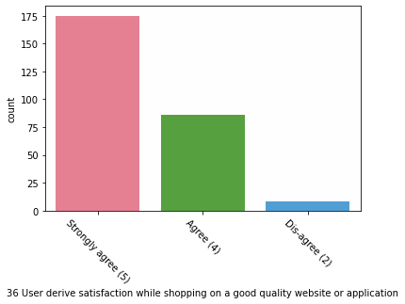

Slide 14
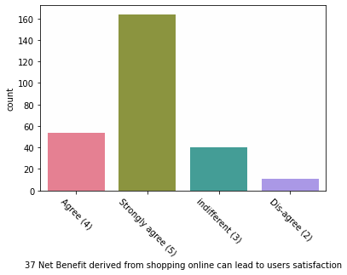
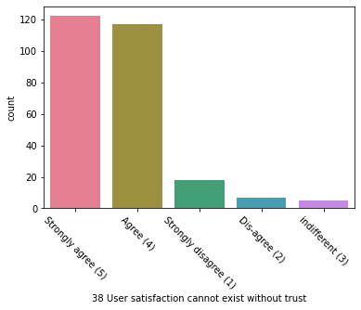
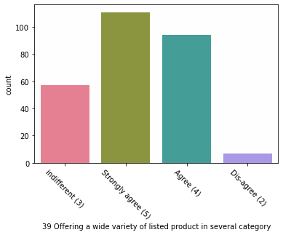
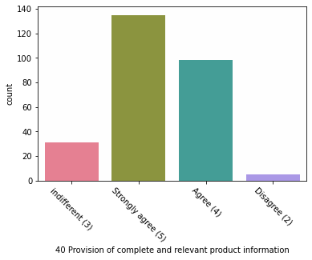

Slide 15
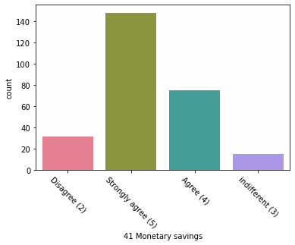
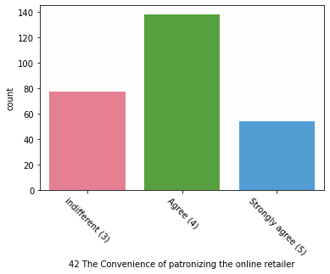
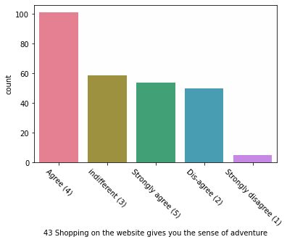
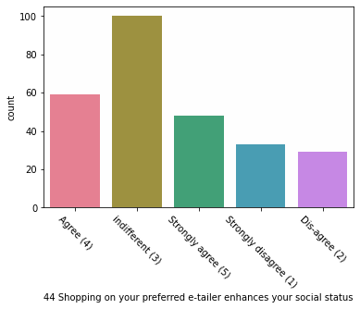

Slide 16
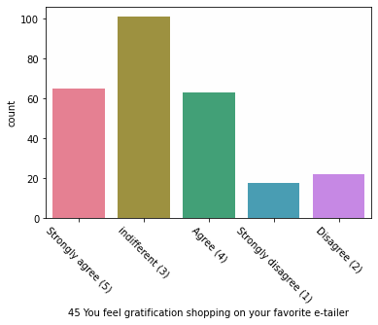
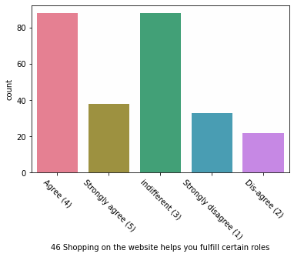
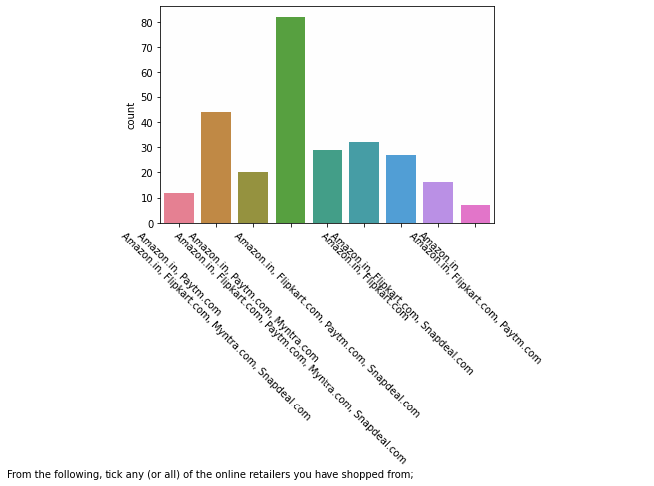
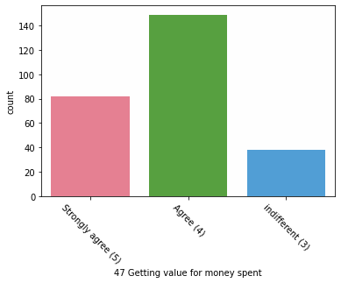

Slide 17



Slide 18




Count Plot based on Gender

Slide 19



Slide 20

Group By function

Slide 21


Categorical plot

Slide 22



Slide 23


Model Building
Label Encoding
Skewness

Slide 24


Scaling.
SMOTE for imbalance

Slide 25



Model Training

Slide 26
Conclusion
From EDA of the data there are more female customers than male ones.
Count plot individually as well as with respect gender was plotted.
Summary statistics whose table is given above tells many things about all the columns present in the dataset. This summary will let us know all important aspects of customer response, opinion, choice and interest for online shopping websites.
Group by function was used to see the trust worthiness of both male and female from various cities from where they shop online. Categorical plot also was plotted to give more clear picture.
Later, after label encoding, skewness and scaling the data was trained with Logistic Regression which gave an accuracy score of 0.9134 or 91.34%.

